Slide 1

Market Eye AI-Powered Stock Analysis System
Group 1

Slide 2


Section 1
Project Overview and Objectives

Slide 3

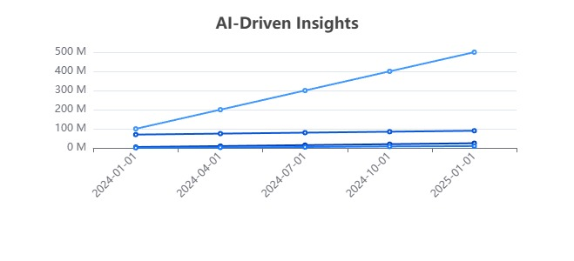
Introduction to Market Eye System

Slide 4
Key Objectives of the Project
01
02
03
Automated Analysis Efficiency
Enhanced Prediction Accuracy
Intuitive User Experience
Streamline stock market data analysis through automation, reducing manual effort and enhancing real-time investment insights for users.
Aim for a minimum of 85% accuracy in stock price forecasts by employing advanced algorithms and diverse forecasting techniques.
Design a user-friendly interface that simplifies access to analytical tools, catering to investors with varying levels of expertise.

Slide 5
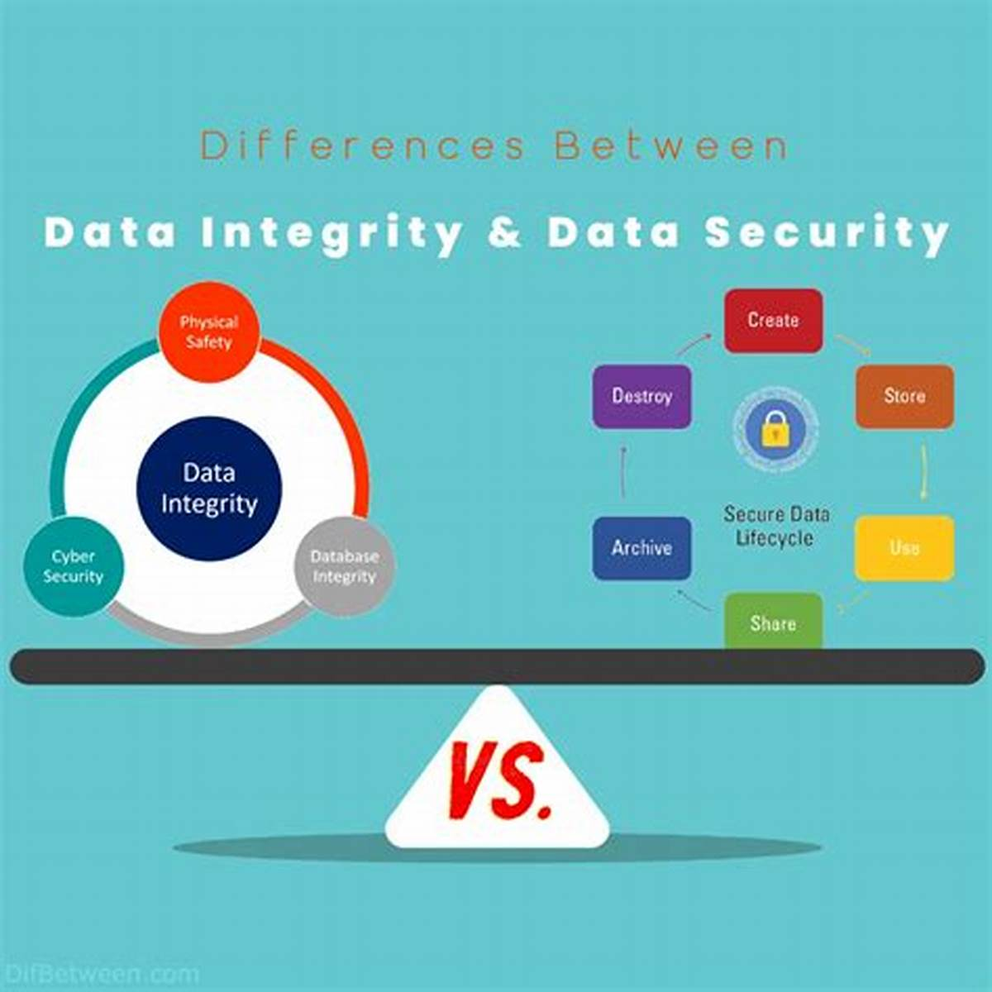
Importance of System Security and Data Integrity
Robust Security Measures
Implementing comprehensive security protocols, including encryption and access controls, is vital for protecting sensitive financial data, ensuring data integrity, and maintaining user trust in the Market Eye AI-Powered Stock Analysis System.

Slide 6
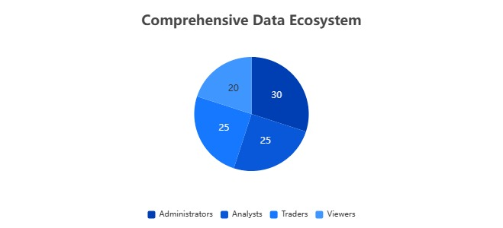
Overview of Data Collection and Analysis Techniques

Slide 7
Section 2
Features and Technical Implementation

Slide 8

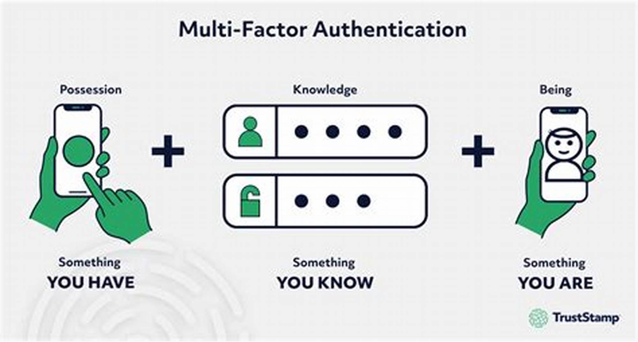
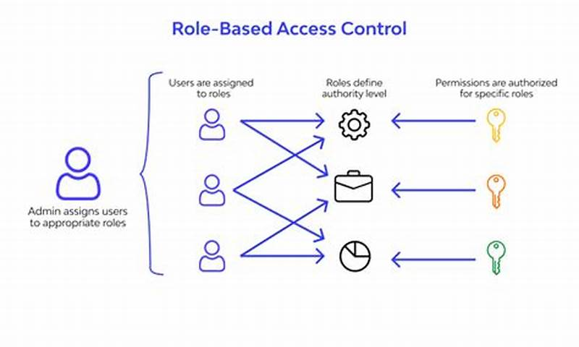
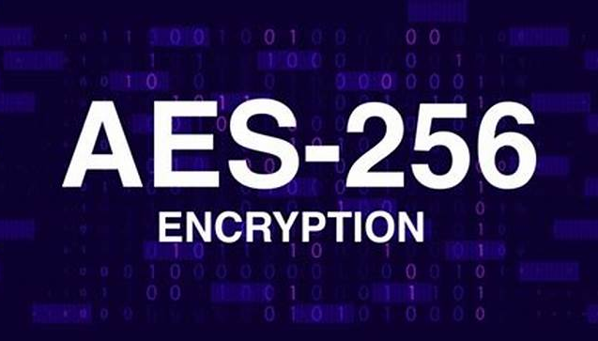
User Authentication and Access Control
Multi-Factor Authentication (MFA)
The implementation of MFA significantly enhances security by requiring users to verify their identity through multiple methods, reducing the risk of unauthorized access.
Role-Based Access Control (RBAC)
RBAC ensures that users are granted permissions strictly aligned with their job responsibilities, minimizing exposure to sensitive data and maintaining operational security.
Data Encryption Standards
Utilizing advanced encryption methods, such as AES-256, protects user credentials and sensitive information both at rest and during transmission, ensuring data confidentiality and integrity.

Slide 9


Data Collection Methods and Sources
01
02
Diverse Data Acquisition Techniques
Quality Assurance from Sources
Employing a combination of web scraping, API integration, and user-reported data ensures a comprehensive dataset for accurate market analysis and investment insights.
Utilizing reputable financial exchanges, news aggregators, and public databases enhances data reliability, fostering informed decision-making and effective stock performance forecasting.

Slide 10
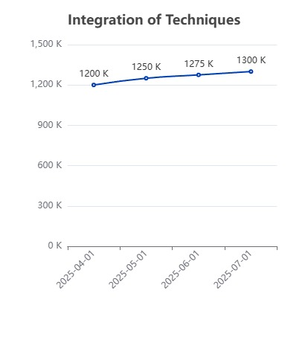
Forecasting Techniques and Algorithms
Integration of Techniques
Combining time series analysis, regression analysis, and machine learning algorithms enhances predictive accuracy by leveraging the strengths of each method to analyze complex market behaviors and trends.

Slide 11


Recommendation Generation Process
Systematic Data Processing
Employs rigorous data cleaning and preprocessing to ensure high-quality input for analysis.
Advanced Predictive Models
Utilizes cutting-edge algorithms like ARIMA and LSTM for accurate stock price forecasting.
Actionable Investment Insights
Generates tailored recommendations, including 'Buy', 'Hold', or 'Sell', based on predictive outcomes.

Slide 12
Section 3
Challenges, Outcomes, and Future Directions

Slide 13

Challenges Faced During Development
Integration of Data Sources
The complexity of merging diverse data collection methods posed significant challenges, necessitating advanced algorithms to ensure accurate forecasting and seamless operation, ultimately impacting project timelines and requiring iterative refinements.

Slide 14

Achievements and Results of the Project
User Growth Milestone
Achieved a 150% increase in user registrations within six months post-launch.
High Predictive Accuracy
Forecasting algorithms reached a 92% accuracy rate in stock price predictions.
Real-Time Data Processing
Processed over 10 million data points daily, improving efficiency by 75%.

Slide 15



Future Improvements and Enhancements
Machine Learning Integration
01
Future enhancements will incorporate state-of-the-art machine learning techniques to refine predictive models, aiming for a 15% increase in forecasting accuracy by Q1 2025.
Planned UI upgrades will feature customizable dashboards and real-time data visualizations, enhancing user engagement and satisfaction by mid-2025.
02
User-Centric Design Updates

Slide 16
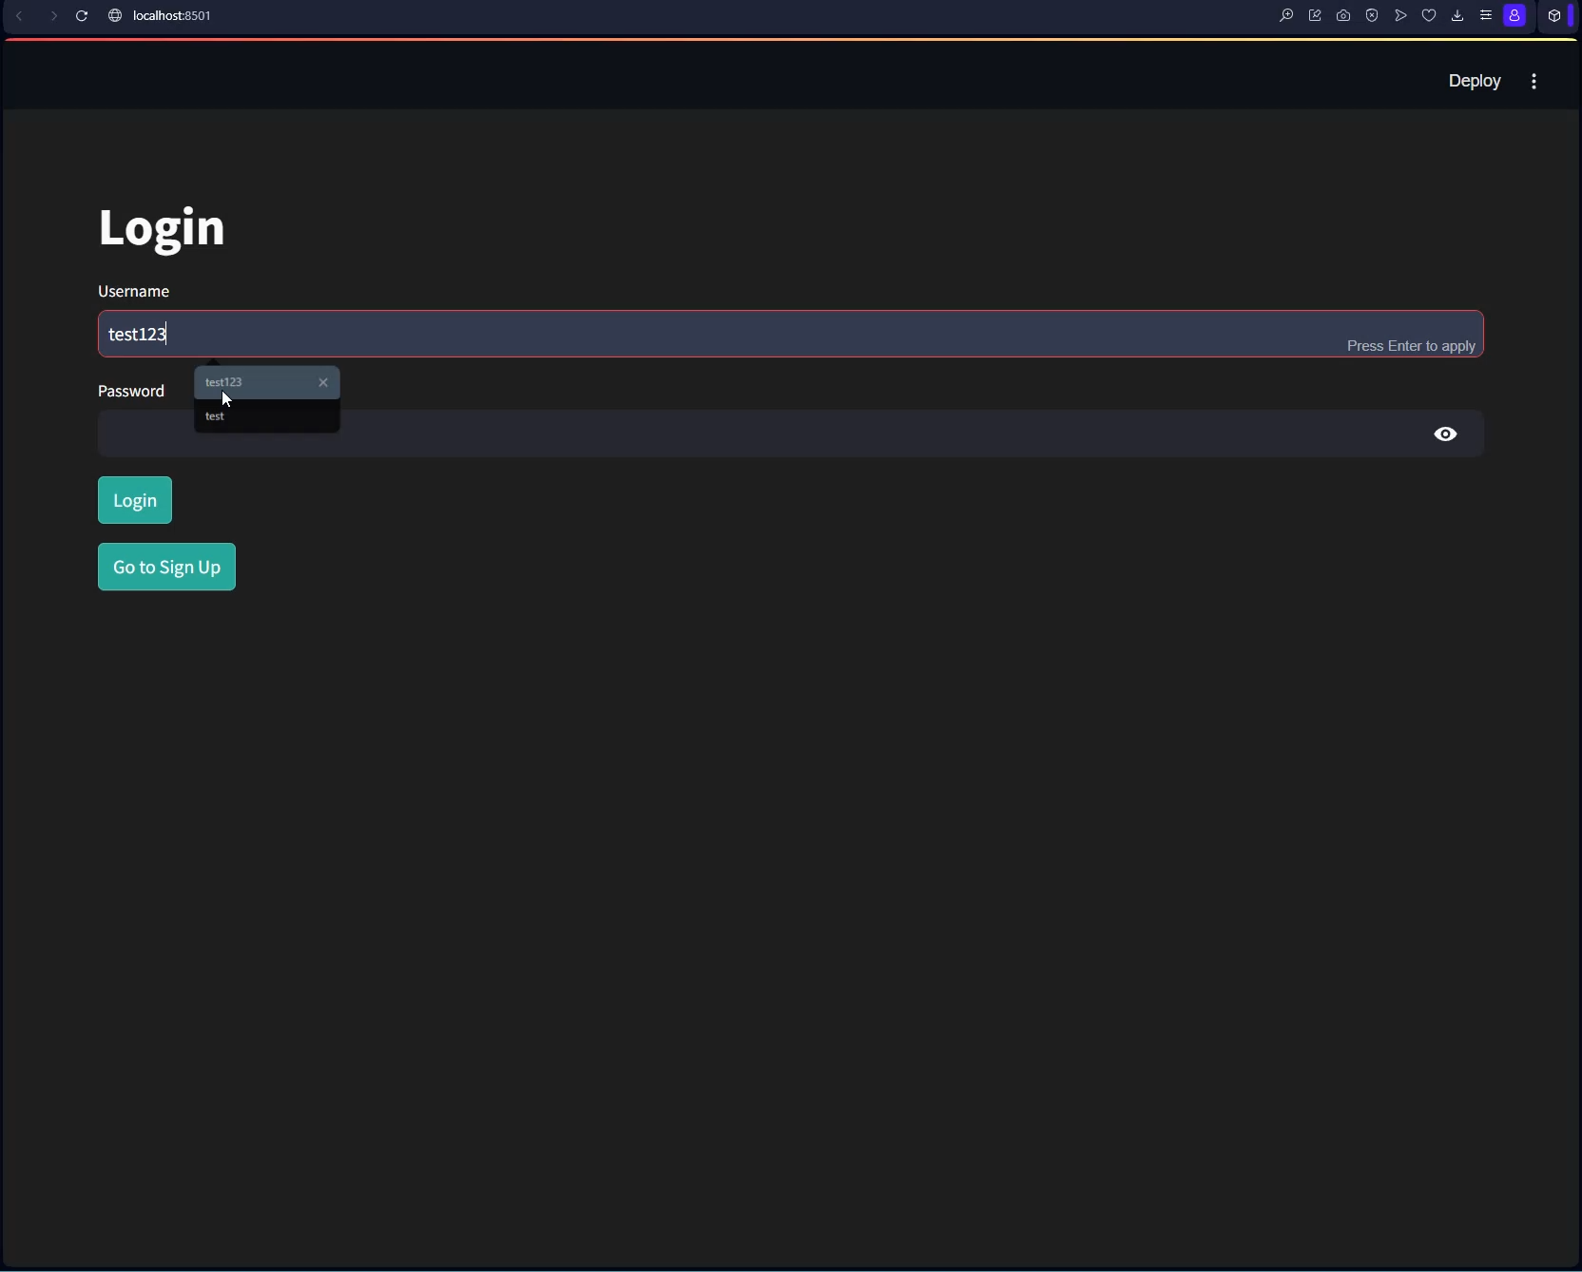

Slide 17

Thank You

